Slide 1

Personal Budget Tracker – G R O U P 25 Project Presentation
An effective tool for managing personal finances
Notes:
AI-generated content may be incorrect. ---

Slide 2
Personal Budget Tracker Project Overview
Notes:
--- This slide references information from the following file: https://atuedughana-my.sharepoint.com/personal/01243179b_st_atu_edu_gh/_layouts/15/Doc.aspx?sourcedoc=%7B2CEDED60-1258-4C3C-BA2E-FBF04C2BF279%7D&file=BEE_208_Non_Technical_Project_Question_14_Personal_Budget_Tracker.docx&action=default&mobileredirect=true Title and Project Identification, Project Background, Problem Statement, Aim and Objectives, Application Requirements, Algorithm Overview, C++ Concepts Used, Budget Status Logic, Sample Output, Conclusion

Slide 3

Title and Project Identification
Project Context
The project is part of a C++ programming course focusing on practical application of fundamental concepts.
Project Purpose
The Personal Budget Tracker helps manage everyday financial challenges faced by students and households.
Technical Focus
Uses C++ core constructs like input/output, loops, conditionals, and file handling for implementation.
Presentation Significance
Title slide establishes professionalism and prepares audience for project discussion and defence.
Notes:
--- This slide references information from the following file: https://atuedughana-my.sharepoint.com/personal/01243179b_st_atu_edu_gh/_layouts/15/Doc.aspx?sourcedoc=%7B2CEDED60-1258-4C3C-BA2E-FBF04C2BF279%7D&file=BEE_208_Non_Technical_Project_Question_14_Personal_Budget_Tracker.docx&action=default&mobileredirect=true This presentation introduces the Personal Budget Tracker project developed as part of the BEE 208 C++ Programming course at Accra Technical University. The project is categorized as a non-technical application, meaning it focuses less on complex algorithms and more on applying fundamental programming concepts to solve a real-life problem. The title slide sets the academic and institutional context by clearly stating the course code, project title, and university. This helps examiners and panel members immediately understand the purpose and scope of the work. The project itself addresses everyday financial challenges faced by students, workers, and small households, making it highly relevant and practical. By using C++ as the implementation language, the project demonstrates how core programming constructs such as input/output, loops, conditionals, and file handling can be applied to personal finance management. The title slide also establishes professionalism and organization, which are important assessment criteria during project defence. Overall, this slide serves as an entry point into the project narrative, preparing the audience for a structured discussion of the background, problem statement, objectives, system design, implementation, and outcomes.

Slide 4

Project Background
Importance of Financial Planning
Personal budgeting helps people monitor income, expenses, and savings for better financial health.
Multiple Income and Expense Sources
Income can come from salaries, allowances, or businesses while expenses cover necessities and personal needs.
Simple Console-Based Application
The project offers a console-based C++ app to enter transactions and get financial summaries easily.
Academic and Social Relevance
This project connects programming theory to real-life budgeting, emphasizing usability and social impact.
Notes:
--- This slide references information from the following file: https://atuedughana-my.sharepoint.com/personal/01243179b_st_atu_edu_gh/_layouts/15/Doc.aspx?sourcedoc=%7B2CEDED60-1258-4C3C-BA2E-FBF04C2BF279%7D&file=BEE_208_Non_Technical_Project_Question_14_Personal_Budget_Tracker.docx&action=default&mobileredirect=true The background of the Personal Budget Tracker project is rooted in the importance of financial planning in daily life. Personal budgeting enables individuals to monitor how income is earned, how expenses are incurred, and how savings can be achieved over time. Many people receive income from multiple sources such as salaries, allowances, or small businesses, while also spending on necessities like food, transport, utilities, and personal needs. Without a structured way of recording these transactions, it becomes difficult to assess financial health. This project was designed to respond to this challenge by providing a simple, console-based C++ application that allows users to enter income and expenses and receive a clear financial summary. From an academic perspective, the background also highlights the intention of the course to train students in problem-solving using programming. The project links theoretical knowledge from lectures to a realistic application scenario. By focusing on budgeting, the project demonstrates social relevance, usability, and simplicity, all of which are key considerations in non-technical programming projects.

Slide 5

Problem Statement
Lack of Financial Tracking
Many individuals do not track their income and expenses, causing poor financial decisions and overspending.
Student Financial Stress
Students face financial stress due to limited income and unplanned spending without proper budgeting tools.
Need for Simple Tracking System
There is a clear need for an easy-to-use, accurate tracking system summarizing financial data effectively.
Notes:
--- This slide references information from the following file: https://atuedughana-my.sharepoint.com/personal/01243179b_st_atu_edu_gh/_layouts/15/Doc.aspx?sourcedoc=%7B2CEDED60-1258-4C3C-BA2E-FBF04C2BF279%7D&file=BEE_208_Non_Technical_Project_Question_14_Personal_Budget_Tracker.docx&action=default&mobileredirect=true The core problem addressed by this project is the lack of proper financial record-keeping among many individuals. People often spend money without tracking their income and expenses, which leads to poor financial decisions, overspending, and inability to save. For students especially, limited income combined with unplanned spending can result in financial stress. The absence of a simple tracking system makes it hard to determine whether one is living within their means. This project identifies that gap and proposes a solution in the form of a Personal Budget Tracker application. The problem statement clearly defines the need for a system that is easy to use, accurate, and capable of summarizing financial data in a meaningful way. By framing the problem in simple terms, the project ensures that the solution remains focused on user needs rather than unnecessary technical complexity.

Slide 6

Aim and Objectives
Project Aim
Develop a C++ Personal Budget Tracker to record and classify income and expenses accurately.
Core Functional Objectives
Accept multiple records, calculate totals, validate inputs, and generate clear financial reports.
Documentation and Submission
Save reports to text files and use GitHub with Markdown for proper project documentation and submission.
Notes:
--- This slide references information from the following file: https://atuedughana-my.sharepoint.com/personal/01243179b_st_atu_edu_gh/_layouts/15/Doc.aspx?sourcedoc=%7B2CEDED60-1258-4C3C-BA2E-FBF04C2BF279%7D&file=BEE_208_Non_Technical_Project_Question_14_Personal_Budget_Tracker.docx&action=default&mobileredirect=true The main aim of the project is to develop a C++ Personal Budget Tracker that records income and expenses, calculates totals, determines the remaining balance, and classifies the user’s budget status. To achieve this aim, several specific objectives were outlined. These include accepting multiple income and expense records, performing accurate calculations, validating user input to prevent negative values, and presenting a clear financial report. Additional objectives involve saving the final budget report to a text file and using GitHub with Markdown documentation for submission. Together, these objectives ensure that the project is not only functional but also well-documented and aligned with academic requirements. The clear definition of aims and objectives guides both the development process and the evaluation of the final system.

Slide 7
Application Requirements
Condition | Budget Status
Total Income > Total Expenses | Surplus / Saving
Total Income = Total Expenses | Balanced Budget
Total Income < Total Expenses | Overspending Warning
Notes:
--- This slide references information from the following file: https://atuedughana-my.sharepoint.com/personal/01243179b_st_atu_edu_gh/_layouts/15/Doc.aspx?sourcedoc=%7B2CEDED60-1258-4C3C-BA2E-FBF04C2BF279%7D&file=BEE_208_Non_Technical_Project_Question_14_Personal_Budget_Tracker.docx&action=default&mobileredirect=true The application requirements define what the Personal Budget Tracker must be able to do. These include allowing the user to enter their name and budget period, record multiple income sources and expense categories, and reject any negative values. The system must calculate total income, total expenses, and the remaining balance. It must also classify the budget status using decision rules and save the final report to a text file. These requirements ensure that the application meets both functional and academic standards. They also serve as a checklist for testing and validation, making it easier to confirm that the system works as intended.

Slide 8
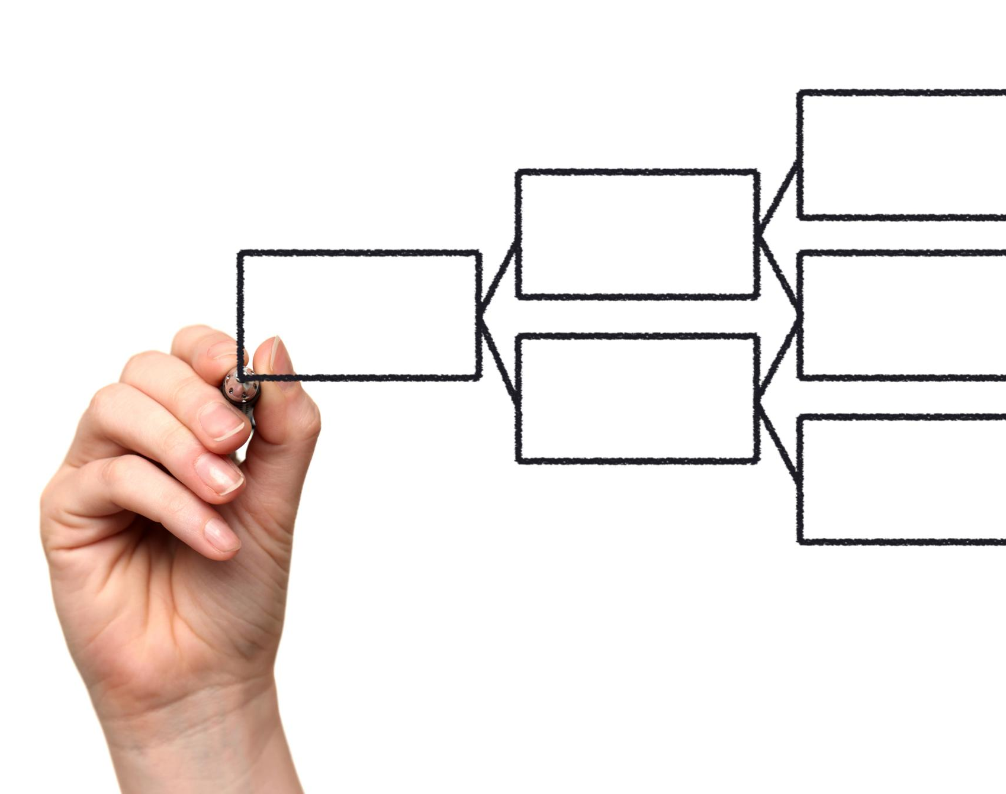
Algorithm Overview
User Information Collection
The system begins by displaying the title and collecting user details like name and budget period.
Income and Expense Entry
Loops allow multiple income and expense entries with input validation to prevent negative values.
Balance Calculation
The algorithm calculates remaining balance by subtracting total expenses from total income.
Budget Status and Reporting
Decision statements classify budget status and the system displays reports and saves to file.
Notes:
--- This slide references information from the following file: https://atuedughana-my.sharepoint.com/personal/01243179b_st_atu_edu_gh/_layouts/15/Doc.aspx?sourcedoc=%7B2CEDED60-1258-4C3C-BA2E-FBF04C2BF279%7D&file=BEE_208_Non_Technical_Project_Question_14_Personal_Budget_Tracker.docx&action=default&mobileredirect=true The algorithm for the Personal Budget Tracker provides a step-by-step description of how the system operates. It starts by displaying the system title and collecting basic user information such as the budget owner’s name and budget period. The algorithm then uses loops to accept multiple income and expense entries, validating each input to ensure no negative values are recorded. After all data is collected, the algorithm calculates the remaining balance by subtracting total expenses from total income. Decision statements are then used to classify the budget status. Finally, the system displays the budget report and saves it to a file. This logical flow ensures clarity, correctness, and ease of implementation.

Slide 9

C++ Concepts Used
Input and Output Operations
Used cin and cout to handle user input and display output effectively in the program.
Variables and Data Types
Stored financial values using appropriate variables and data types to ensure data integrity.
Control Structures
Implemented loops for multiple entries and conditional statements for validation and classification.
Functions, Classes, and File Handling
Used functions and classes for organization, and file handling to save reports.
Notes:
--- This slide references information from the following file: https://atuedughana-my.sharepoint.com/personal/01243179b_st_atu_edu_gh/_layouts/15/Doc.aspx?sourcedoc=%7B2CEDED60-1258-4C3C-BA2E-FBF04C2BF279%7D&file=BEE_208_Non_Technical_Project_Question_14_Personal_Budget_Tracker.docx&action=default&mobileredirect=true Several core C++ programming concepts were applied in this project. Input and output operations were handled using cin and cout. Variables and appropriate data types stored financial values. Loops enabled the recording of multiple income and expense entries. Conditional statements were used for validation and budget classification. Functions and classes improved code organization and readability, while file handling allowed the program to save reports. These concepts collectively demonstrate a solid understanding of introductory C++ programming.

Slide 10

Budget Status Logic
Relational Comparison Logic
Budget status logic uses simple relational comparisons to classify spending behavior accurately.
Financial Status Labels
Clear labeling of saving, balanced, or overspending status helps users understand their finances quickly.
User Decision Support
Meaningful budget feedback supports better spending decisions and improved financial habits.
Notes:
--- This slide references information from the following file: https://atuedughana-my.sharepoint.com/personal/01243179b_st_atu_edu_gh/_layouts/15/Doc.aspx?sourcedoc=%7B2CEDED60-1258-4C3C-BA2E-FBF04C2BF279%7D&file=BEE_208_Non_Technical_Project_Question_14_Personal_Budget_Tracker.docx&action=default&mobileredirect=true The budget status logic is a critical part of the application. It uses simple relational comparisons to determine whether the user is saving, balanced, or overspending. This logic makes the output meaningful and actionable for users. By clearly labeling financial status, the system helps users understand their spending behavior and make better decisions in the future.

Slide 11

Sample Output
Clear Financial Summary
The output clearly presents total income, expenses, remaining balance, and budget status for easy understanding.
User Feedback Confirmation
The sample output confirms the system meets functional requirements and provides valuable user feedback.
Notes:
--- This slide references information from the following file: https://atuedughana-my.sharepoint.com/personal/01243179b_st_atu_edu_gh/_layouts/15/Doc.aspx?sourcedoc=%7B2CEDED60-1258-4C3C-BA2E-FBF04C2BF279%7D&file=BEE_208_Non_Technical_Project_Question_14_Personal_Budget_Tracker.docx&action=default&mobileredirect=true The sample output demonstrates how the application presents results to the user. It displays total income, total expenses, remaining balance, and budget status in a clear and readable format. This output confirms that the system meets its functional requirements and provides useful feedback to the user.

Slide 12

Conclusion
Application of C++ Concepts
Project applies core C++ concepts to effectively address real-world budgeting challenges.
User-Friendly Budget System
System design focuses on simplicity and usability for tracking income and expenses.
Skill Development
Students enhance programming skills and practical problem-solving through project experience.
Preparation for Advanced Projects
Project reinforces good coding practices, documentation, and presentation for future challenges.
Notes:
--- This slide references information from the following file: https://atuedughana-my.sharepoint.com/personal/01243179b_st_atu_edu_gh/_layouts/15/Doc.aspx?sourcedoc=%7B2CEDED60-1258-4C3C-BA2E-FBF04C2BF279%7D&file=BEE_208_Non_Technical_Project_Question_14_Personal_Budget_Tracker.docx&action=default&mobileredirect=true In conclusion, the Personal Budget Tracker project successfully applies fundamental C++ programming concepts to solve a real-world problem. The system is simple, user-friendly, and effective in helping users track income and expenses. Through this project, students demonstrate both technical competence and practical problem-solving skills. The project also prepares students for more advanced applications by reinforcing good programming practices, documentation, and presentation skills.

